Slide 1
Decentralized E-commerce
Varendra Maurya

Slide 2
AGENDA
Introduction​
Motivation
​Objectives
UML Diagrams
​DApp Architecture
Summary

Slide 3
Introduction
This report presents a project idea for a decentralized blockchain-based e-commerce shop that allows customers to purchase products using Ethereum, a popular cryptocurrency. The motivation for the project is to offer customers an alternative payment option that is not reliant on government-accepted currencies, thereby making the shopping experience more convenient and efficient.

Slide 4
Motivation
Traditional e-commerce platforms often rely on intermediaries for transactions, resulting in high transaction fees and limited payment options. Decentralized e-commerce platforms can address these limitations by utilizing blockchain technology, which eliminates intermediaries and promotes transparency and security. Ethereum is a popular cryptocurrency that can be used for transactions on blockchain-based platforms. I choose this project to provide customers with more options to buy their needs using crypto they don’t need to convert their crypto coins to any government-accepted currencies; they can simply buy the goods using their crypto wallet.

Slide 5
Objectives Achieved
The primary objectives of this project include:
Providing a wider range of payment options: Customers can use Ethereum to purchase products, providing a more convenient payment option that is not reliant on government-accepted currencies.
Lowering transaction fees: Without intermediaries involved, transaction fees can be significantly lower than traditional e-commerce platforms.
Creating a decentralized platform: A decentralized platform ensures that the platform is not controlled by any central authority, promoting transparency and decentralization.

Slide 6
UML Diagrams

Slide 7
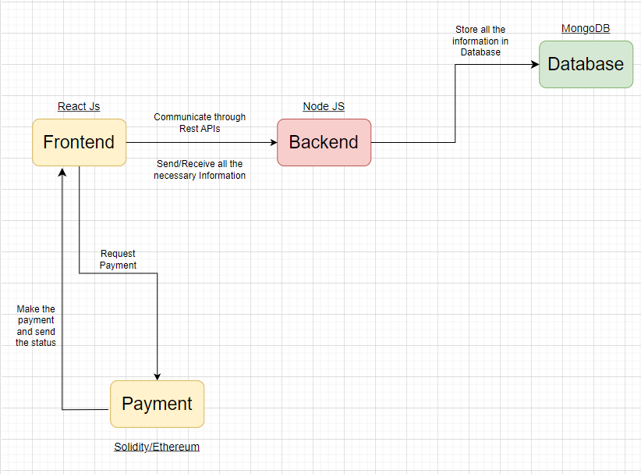
Overall architecture

Slide 8
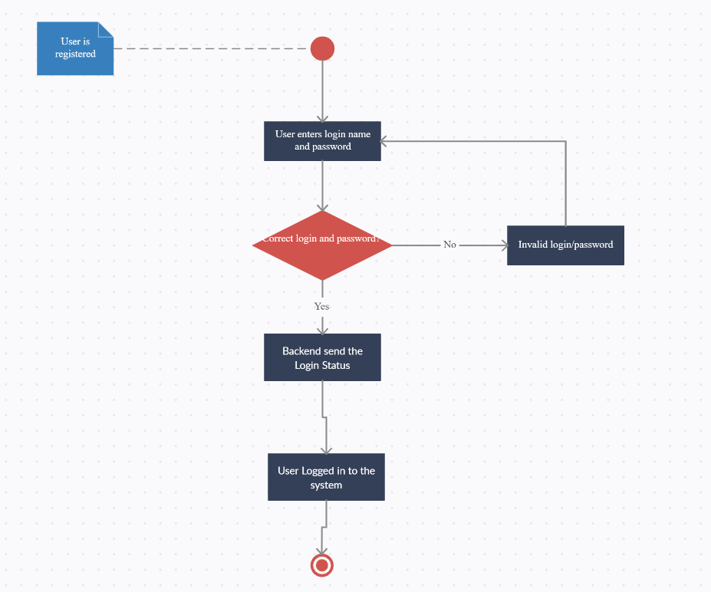
Account Workflow

Slide 9
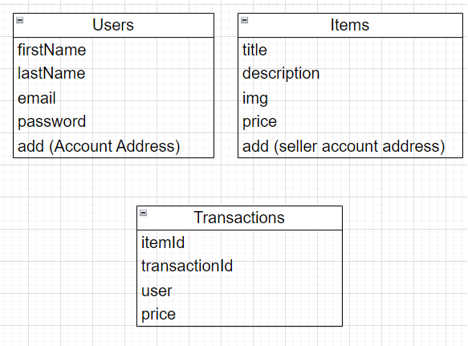
Database Schema

Slide 10
Frontend Features
Create Account
Login Account
Choose Available Wallet
Browse the available Products
Purchase the Items by paying in Ethereum
List the Products to sell
Check all the purchased items
Transaction history

Slide 11
Outputs AND Screenshots of working Architecture

Slide 12
AREAS OF FOCUS
B2B MARKET SCENARIOS
CLOUD-BASED OPPORTUNITIES
Develop winning strategies to keep ahead of the competition
Capitalize on low-hanging fruit to identify a ballpark value
Visualize customer directed convergence
Iterative approaches to corporate strategy
Establish a management framework from the inside

Slide 13
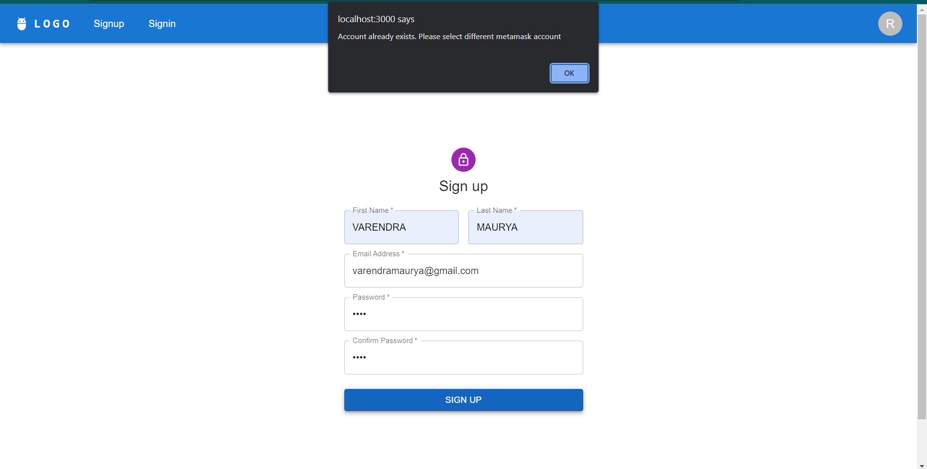
Creating account with Existing Wallet Address

Slide 14
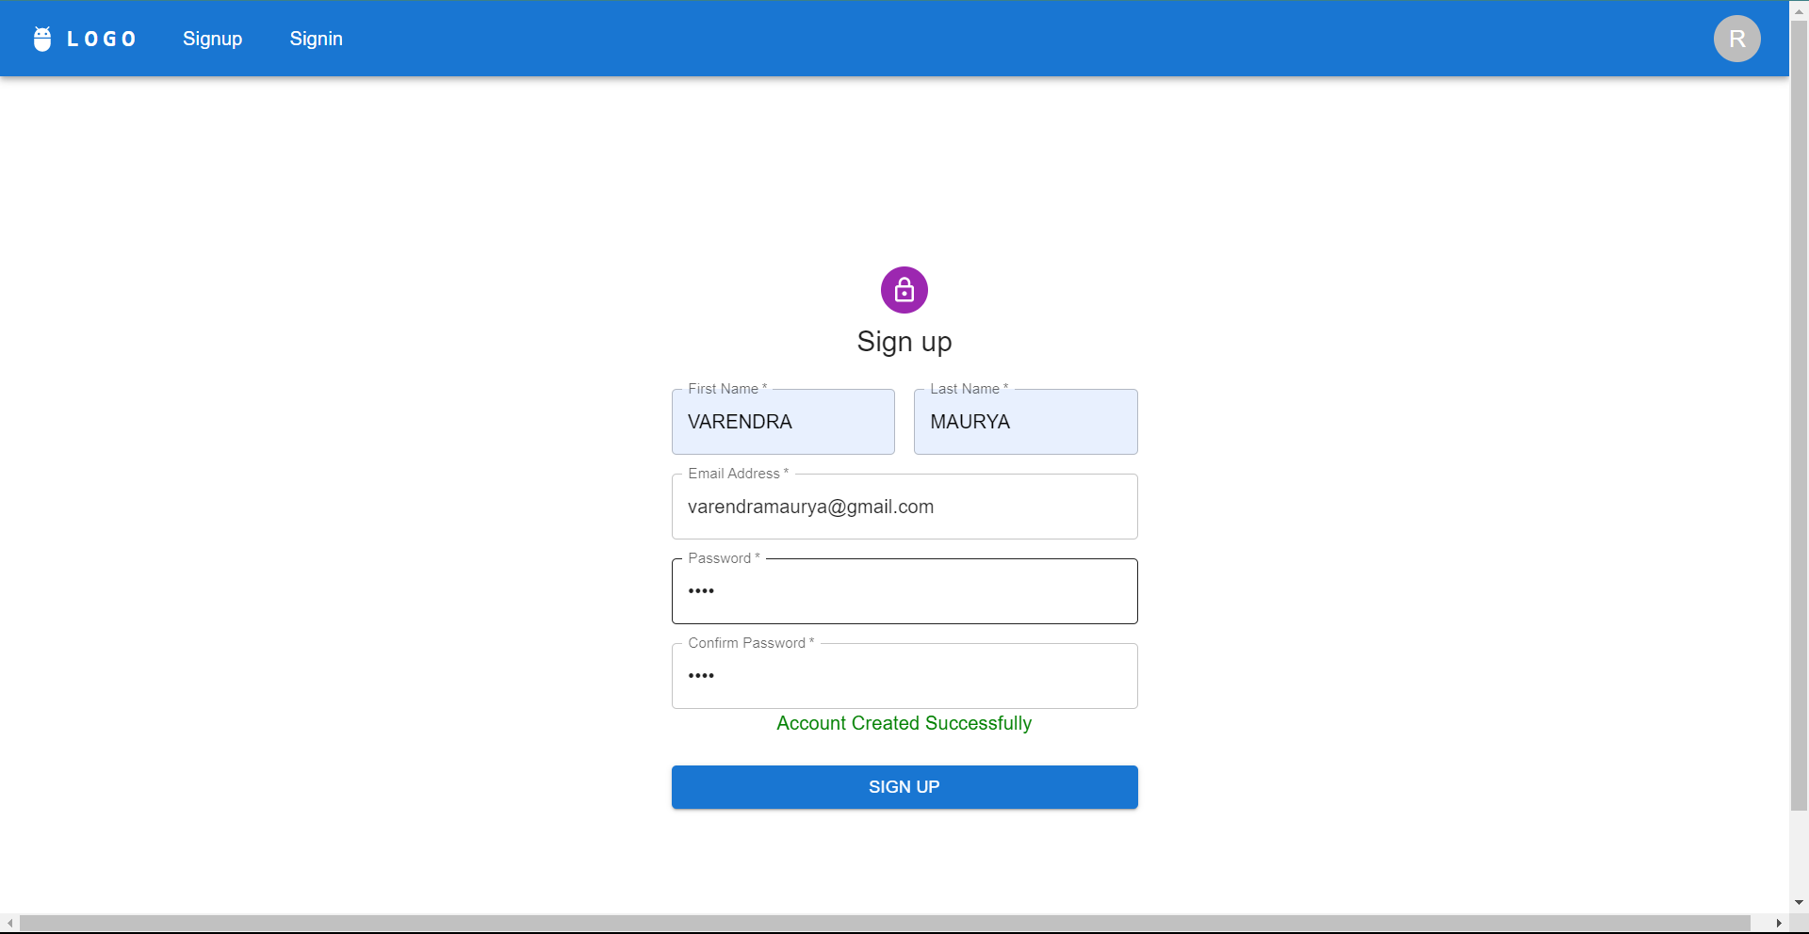
Successful Account Creation

Slide 15
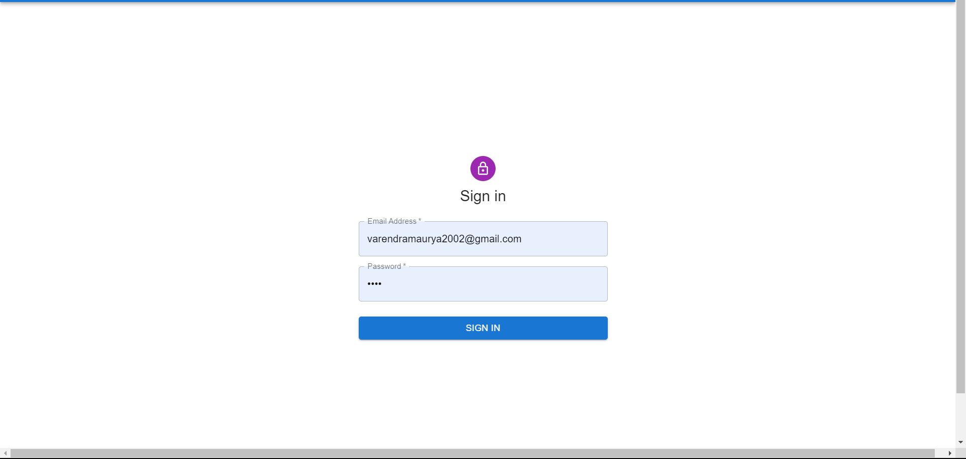
Sign In

Slide 16
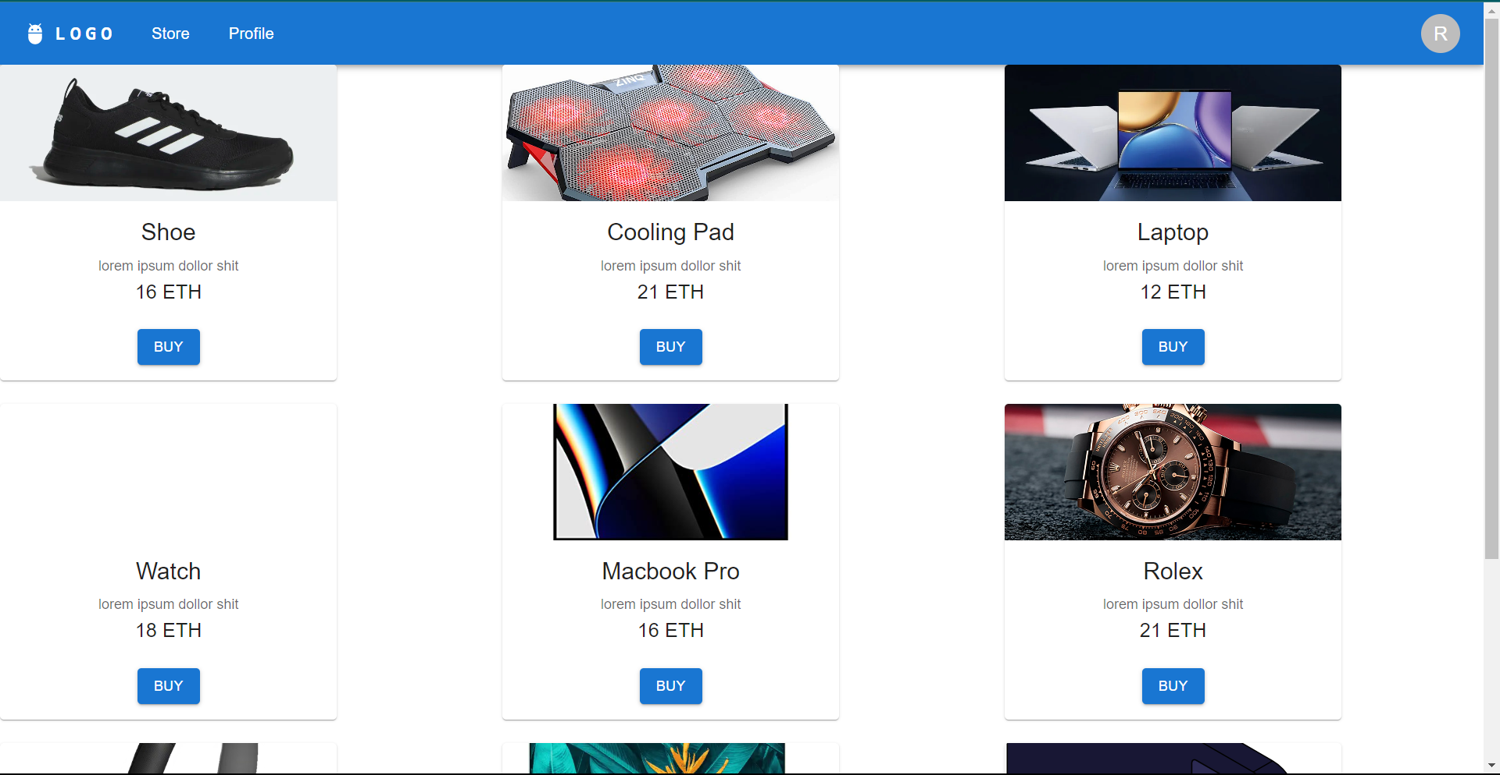
Home/Store

Slide 17
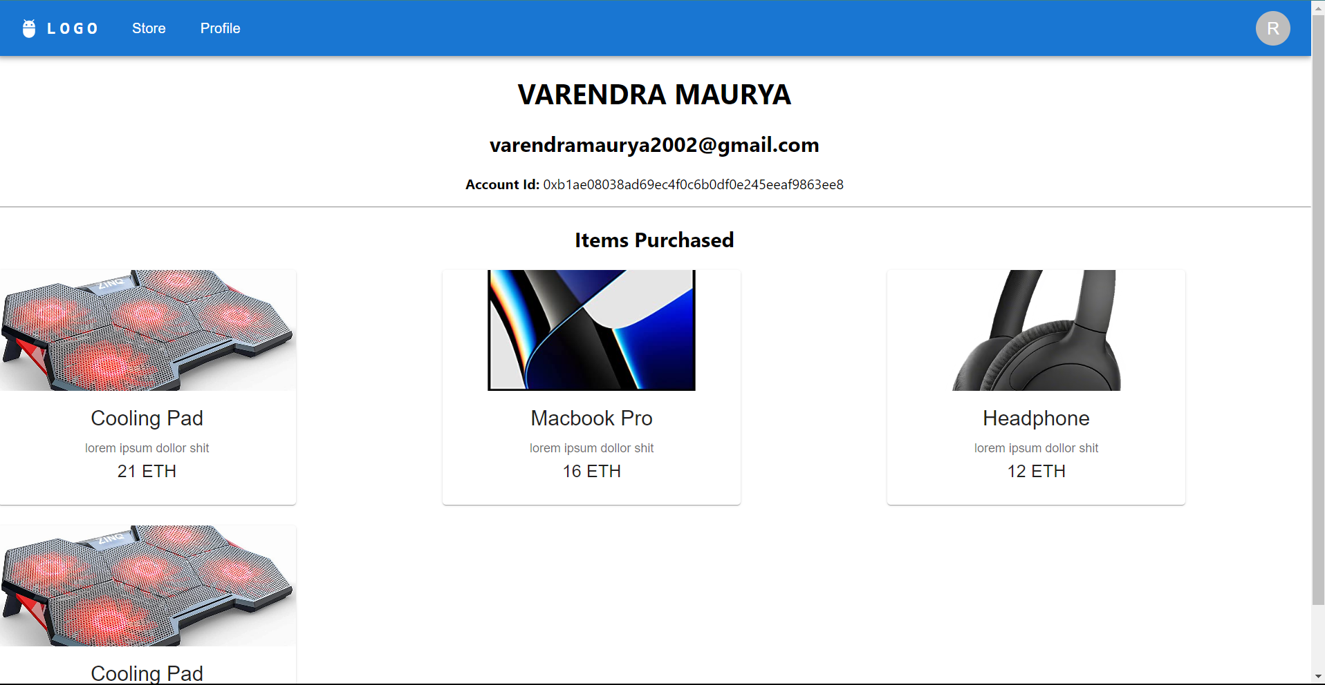
Profile Page

Slide 18
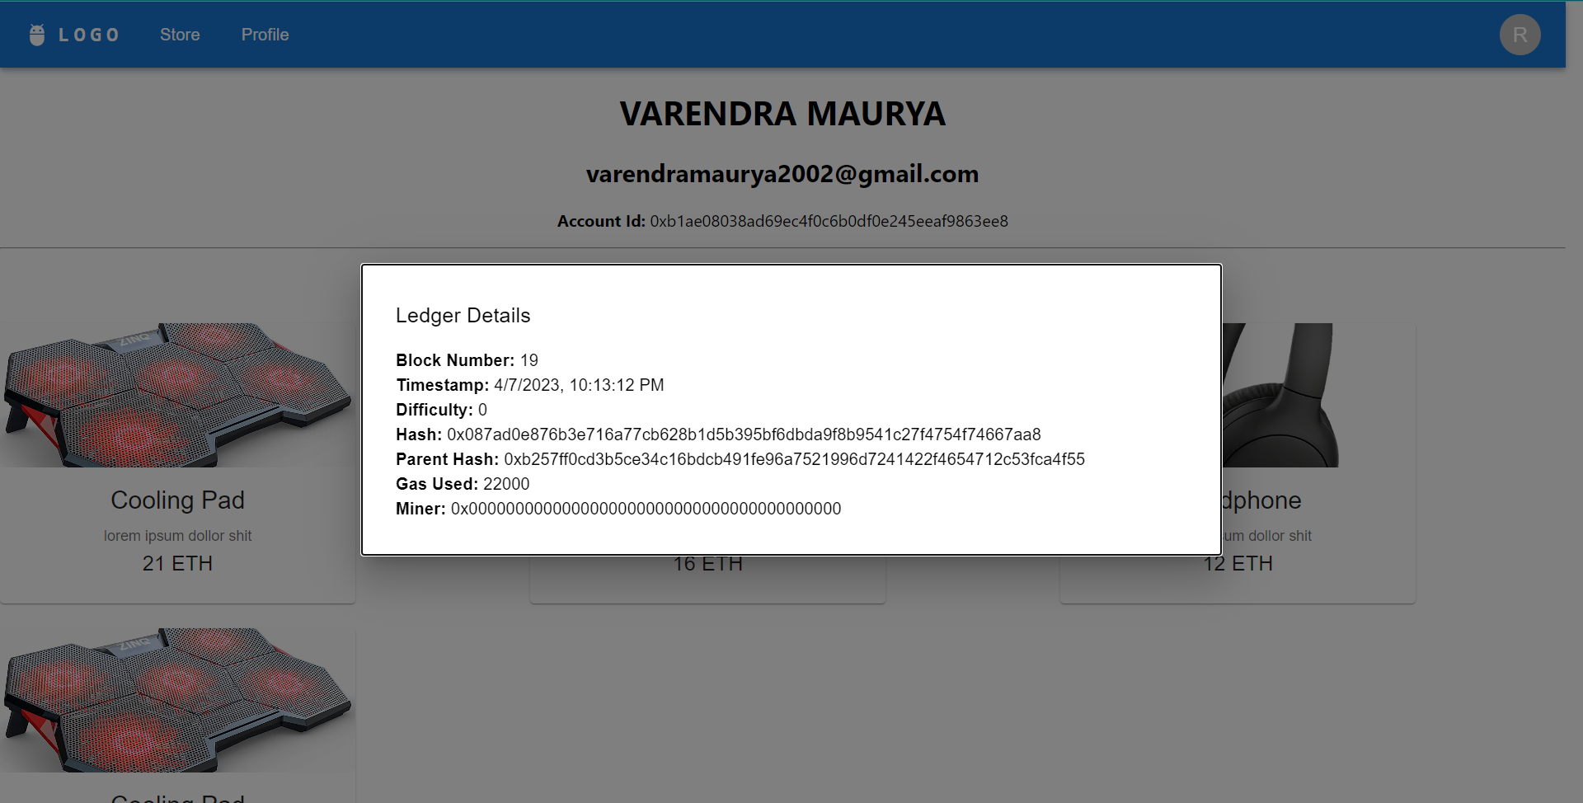
Ledger Details

Slide 19
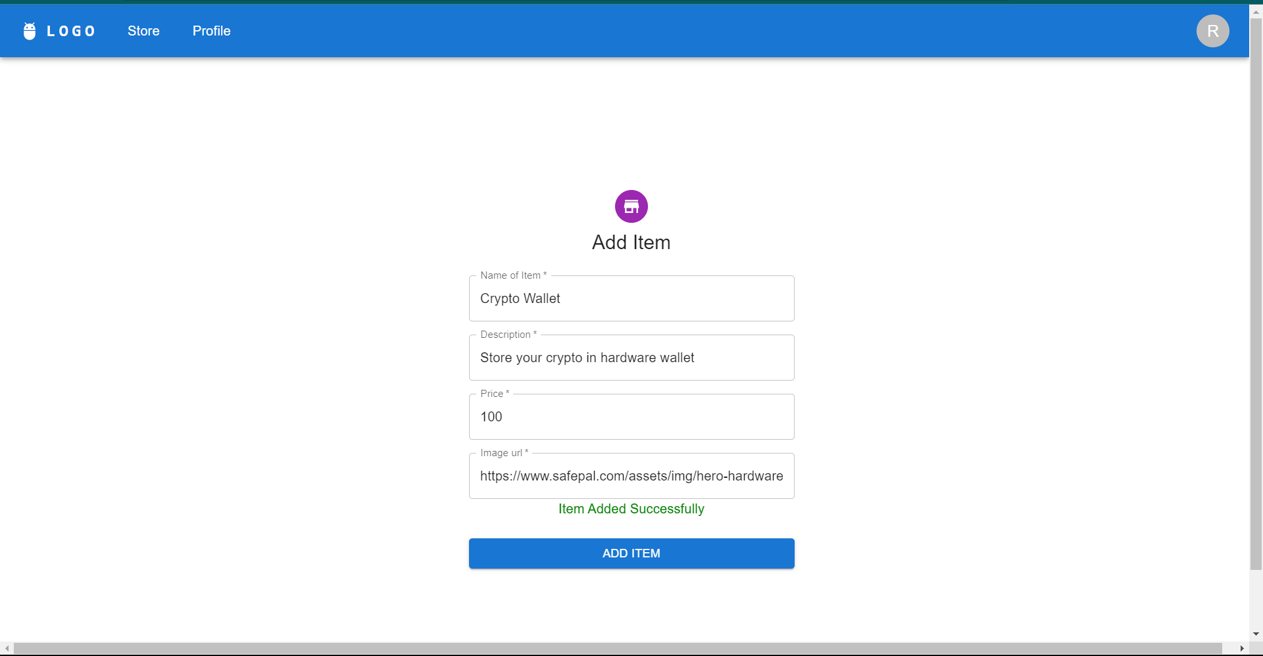
Add Item

Slide 20
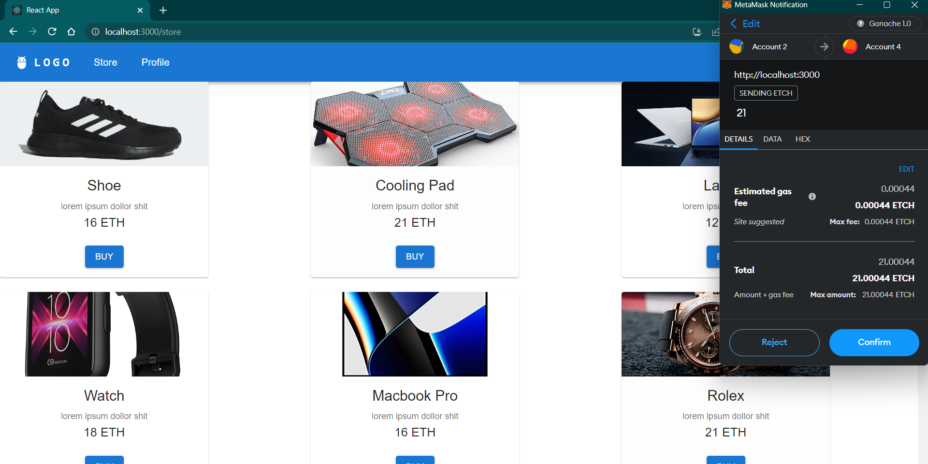
Purchasing Item

Slide 21
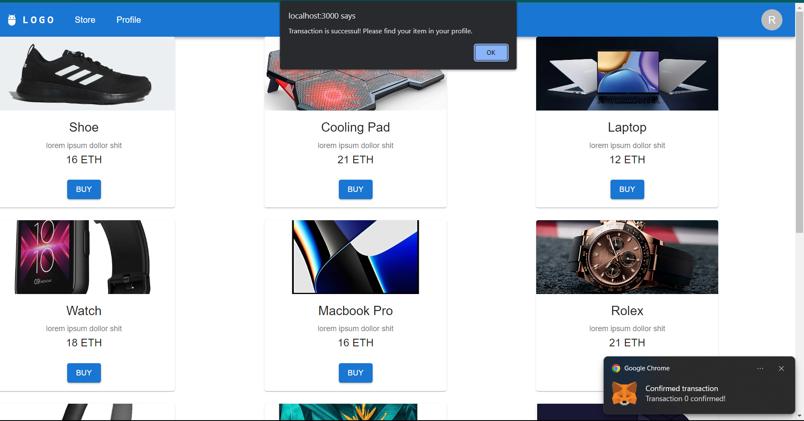
Successful Purchase

Slide 22
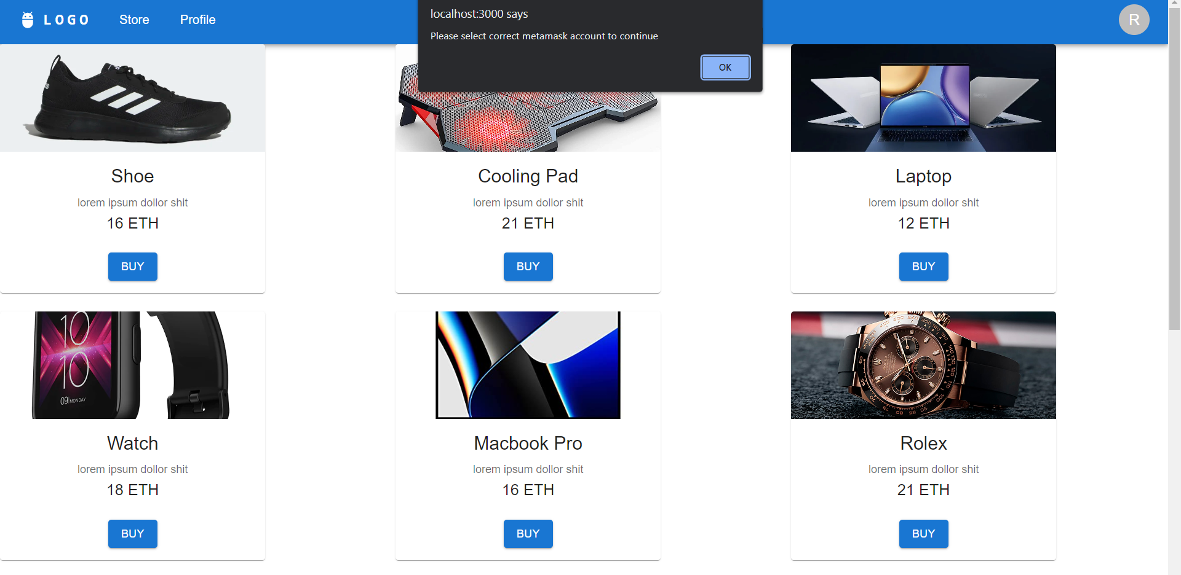
Trying to Access with wrong MetaMask Account

Slide 23
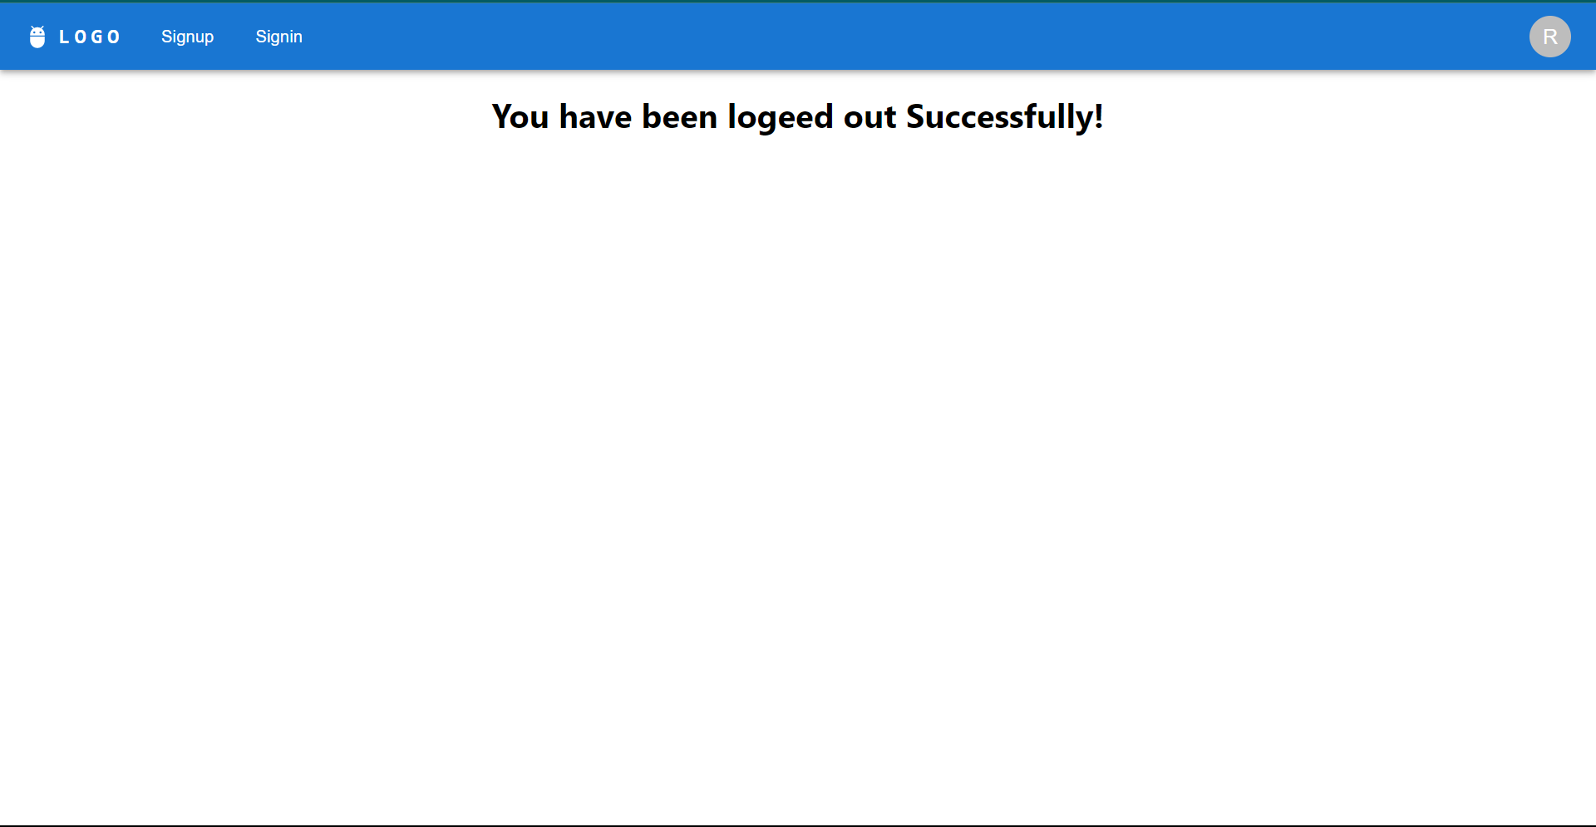
Logout

Slide 24
SUMMARY
In conclusion, the project idea of a decentralized blockchain-based e-commerce shop that accepts Ethereum as payment offers numerous benefits, including a more convenient payment option, lower transaction fees, increased security, and a decentralized platform. By utilizing Ethereum as the primary cryptocurrency for transactions, the platform can provide customers with a user-friendly and efficient way to purchase products while enjoying the benefits of blockchain technology.

Slide 25
THANK YOU
Varendra Maurya
200010055@gmail.com
varendra-maurya.netlify.app

